Slide 1
Polymers: Synthesis by Acyl Substitution Reactions

Slide 2
Contents
Acyl Substitution Reactions, review
Step vs. Chain Growth
Application of acyl substitution in polymer synthesis, commonly known as condensation polymerization

Slide 3
Acyl Substitution Reactions
There are several ways to carry out step-reaction polymerizations, but acyl transfer reactions are among the most common:
Functional group A can be a carboxylic acid or a derivative (such as an acyl chloride) and functional group B acts as the nucleophile is typically an alcohol or amine
Example of acyl substitution reaction between an acyl chloride and amine
Note : Formation of a small molecule (HCl) classifies this as a condensation reaction.

Slide 4
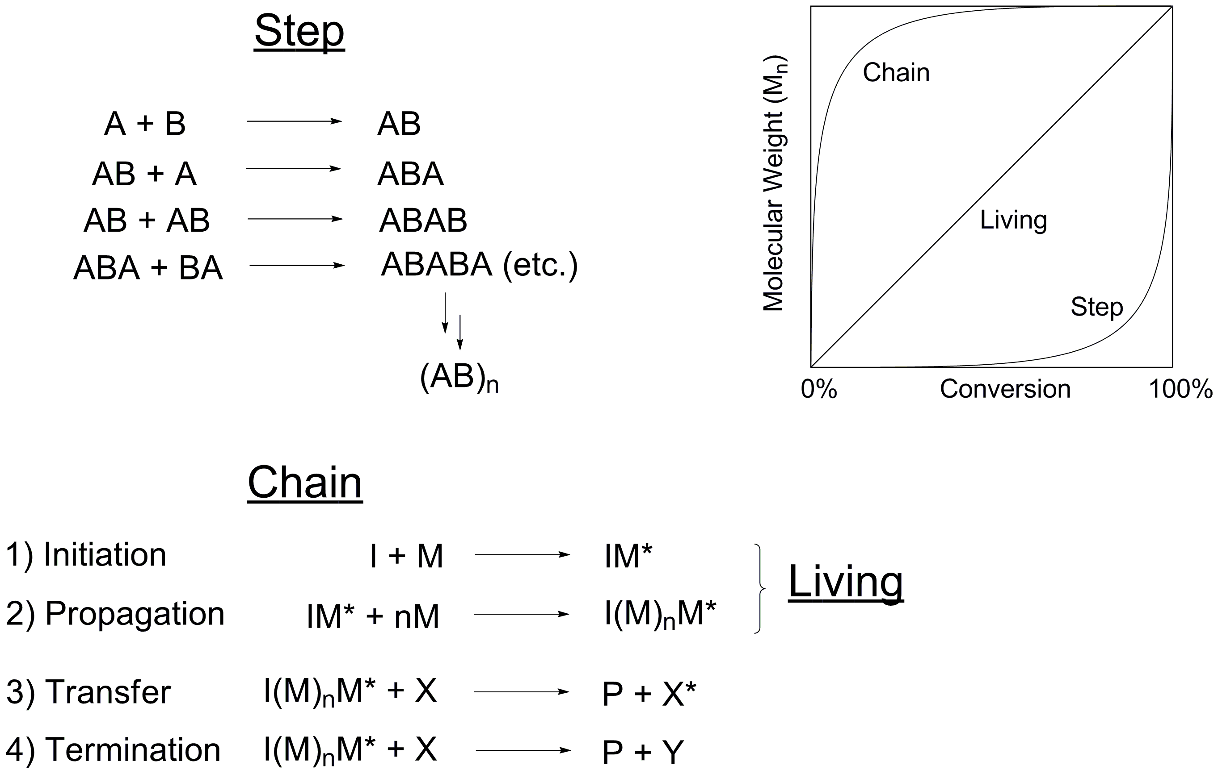
Classification by Mechanism

Slide 5
Molecular Weight vs. Conversion
Chain polymerization: High polymer + monomer in flask between 0-100% conv.
Step polymerization: Oligomers in flask between 0-100% conv.
Conversion is the percent of polymerizable functional groups that have been converted into backbone functional groups.

Slide 6
Step-Growth Monomers
Two common strategies in step polymerizations that rely on acyl substitution reactions:
AB-type monomers: Each monomer contains both the carboxylic derivative and nucleophile. The example below is a trans-esterification reaction.
A and B-type monomers: Each monomer contains identical functional groups on each end.

Slide 7
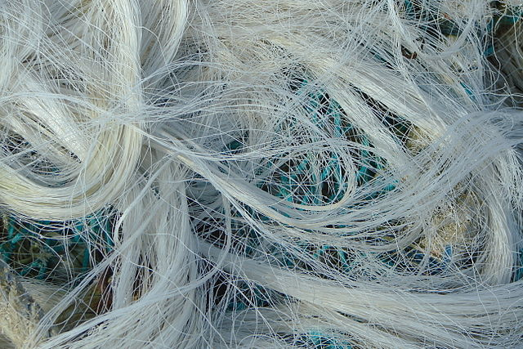
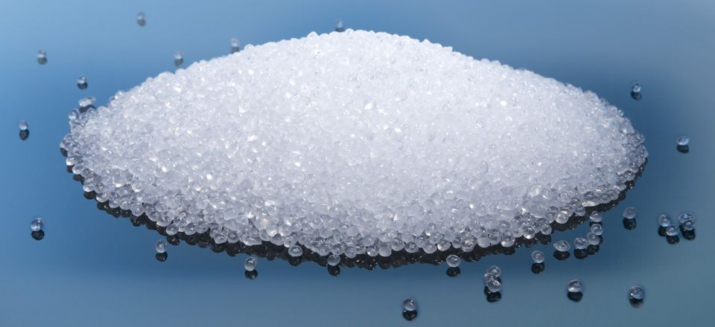
Step Growth Polymerizations
Molecular weights increase slowly compared to chain growth polymerization,
with smaller chain lengths even at high conversions. Weights and dispersity can
be measured by gel permeation chromatography.
Dispersity is much higher than chain growth polymers (such as vinyl polymers),
with a wide array of polymer sizes produced in a step-growth polymerization.
Despite smaller chain lengths, useful properties (high strength, crystallinity)
are obtained in step growth because of functionality in the polymer backbone.
polypropylene
Nylon fibers

