Slide 1
Polymer Characterization:
Nuclear Magnetic Resonance Spectroscopy (NMR)

Slide 2
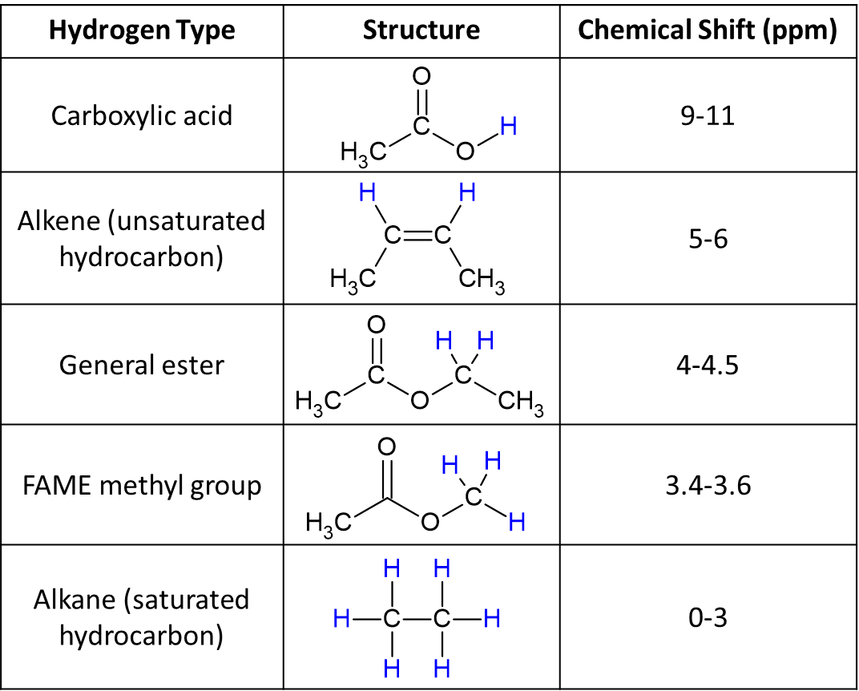
NMR Overview
NMR derives signals from particular nuclei based on the amounts of those nuclei in different chemical environments
NMR is a powerful tool for determining polymer structure and composition
¹H and ¹³C are most used with polymers
Chemical shift, resonance splitting, and resonance integration identify particular nuclei
Most techniques require dissolving the sample in a deuterated solvent

Slide 3
Polymer NMR Limitations
Resonance broadening can make it difficult to resolve closely-spaced signals
Many polymers are poorly soluble or insoluble, making them only accessible to this technique if a solid-state instrument is available
Polymerize
8
6
4
2
0
8
6
4
2
0
ppm
ppm

Slide 4

NMR Uses: Determining % Conversion
In alkene-derived polymers, the integrations of the alkene resonances near 5-6 ppm can be compared to that of a repat unit resonance that is chemically distinct.
+
+
$$\frac{2.00}{2.00+3(0.01)}∙100\%=99\% conv.$$
x
x
x
x
x
¹H NMR spectrum courtesy of Nirob Saha, PhD

Slide 5

NMR Uses:
End-Group Analysis
Unique protons on a chain end can be compared to repeat unit signals to provide an estimate of M_{N}.
*
+
+
$$DP= \frac{192.82}{2.00}=96.4$$
Degree of Polymerization:
$$M_{n}=350.6+96.4\left(100.12\right)=10,003$$
End group mass
Repeat unit mass
*
¹H NMR spectrum courtesy of Nirob Saha, PhD

Slide 6

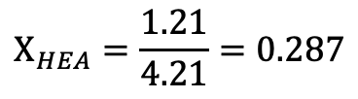
NMR Uses:
Copolymer composition
Comparing protons found in each repeat unit of a copolymer can be used to determine block lengths or monomer ratios.
If x = 2.00, then 3.00 of * int. is from acrylamide (AM)
(1.50+2.71) – 3.00 = 1.21 int. from HEA
*
*
*
*
x
$$Χ_{HEA}=\frac{1.21}{4.21}=0.287$$
*
x
*
$$Χ_{AM}=\frac{3.00}{4.21}=0.713$$
¹H NMR spectrum courtesy of Elizabeth S. Sterner, PhD

