Slide 1
Polymer Characterization: Size Exclusion Chromatography (SEC)

Slide 2
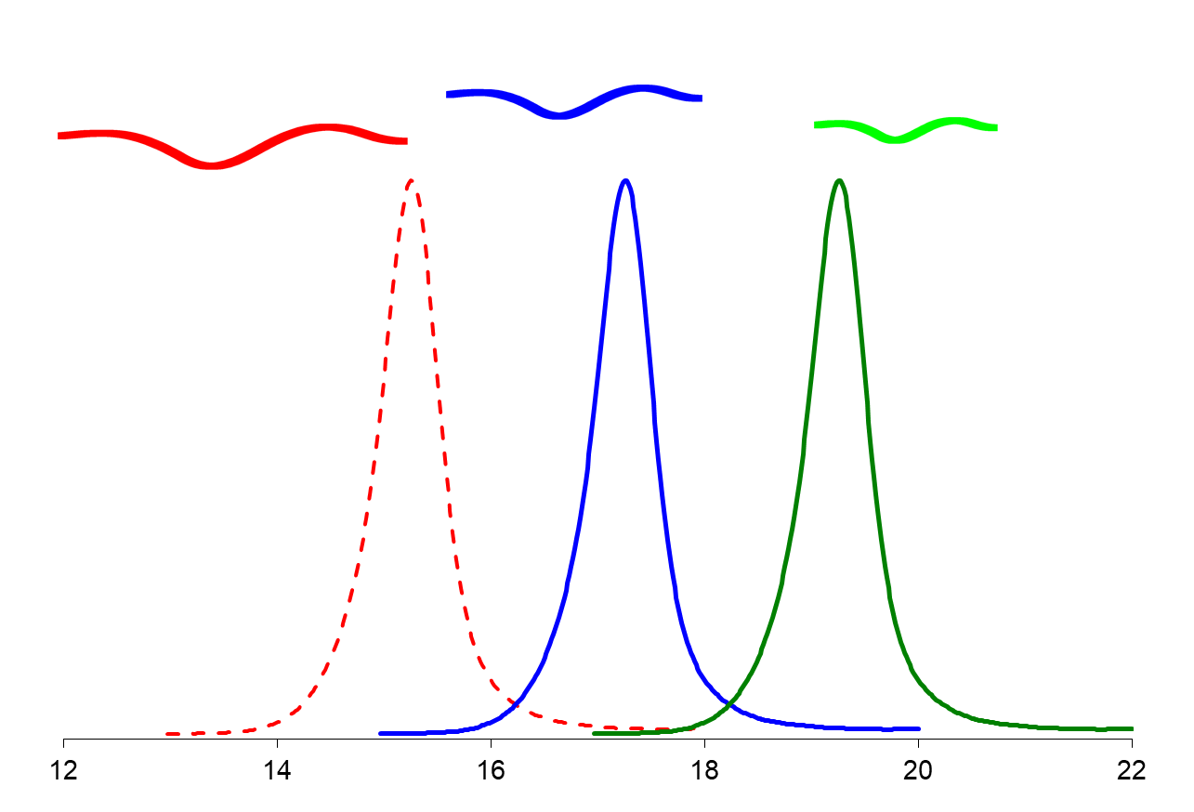
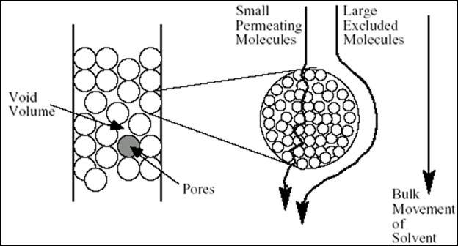
SEC Operation
Overview: SEC is a chromatographic technique that separates polymers based on their size in solution. It provides information on the molar mass and dispersity of polymers.
Elution volume (or time)
SEC columns contain porous beads
No chemical interaction takes place between the polymer and the stationary phase – very much unlike HPLC and GC
Smaller chains get stuck in the pores, so these chains take longer to elute off the column
Larger chains do not permeate into the particles, so they elute first

Slide 3
SEC Detection Methods
Refractive Index
Ubiquitous concentration detector
UV-Vis
Concentration detector for polymers with a chromophore
Viscometry
Measures intrinsic viscosity, polymer size, and density
Multi-Angle Light Scattering
Directly measures absolute molar mass of a polymer independent of chemistry or structure
No calibration curve necessary
Also measures Radius of Gyration (R_{g}) in some cases

Slide 4
SEC Limitations
When using RI/UV detection, SEC is a relative technique that relies on creating appropriate standard curves
Use of MALS detectors avoids this limitation
Technique only works on soluble polymers – crosslinked materials cannot be measured with SEC
High temperature SEC instrumentation can overcome some solubility issues
SEC instruments are notoriously difficult to maintain, stabilize, and calibrate
RI baseline is sensitive to impurities, temperature changes, and salt

Slide 5
SEC Uses: Molecular Weight
Conventional SEC provides estimates of M_{N}, M_{W}, and Ɖ
M_{N}
Dispersity
Ɖ = M_{W}/M_{N}
M_{W}
Standard curve (dotted line)
Standard samples (dots)
Elution volume

Slide 6
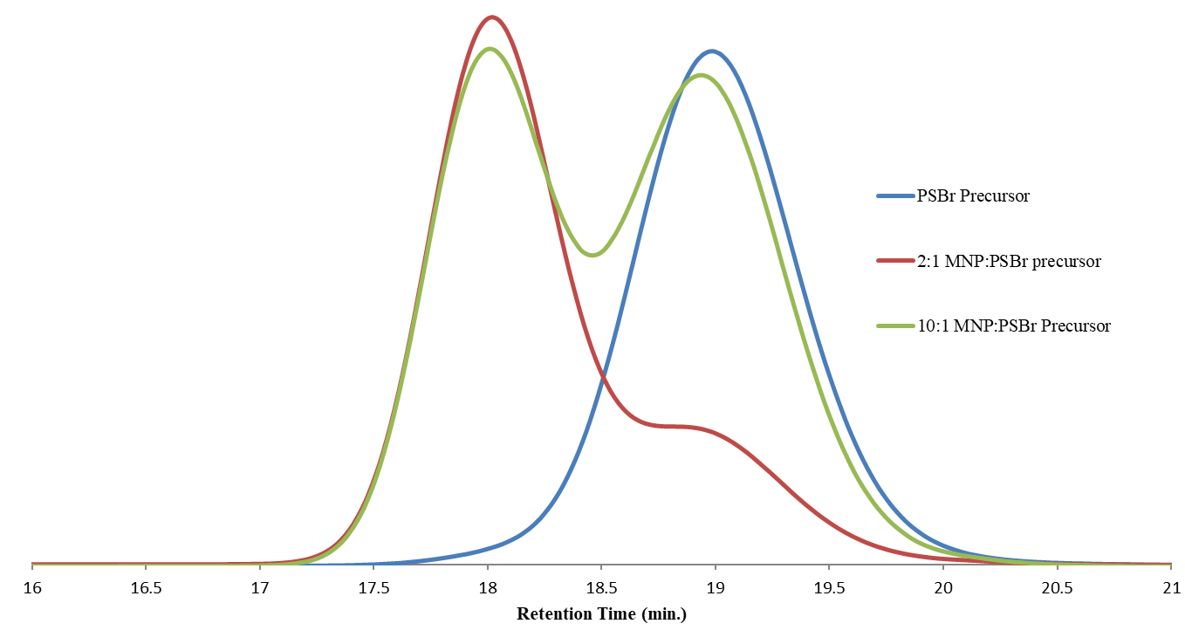
SEC Uses: Detecting Copolymers
SEC data can be used to verify a new block has been added to a precursor polymer. “Shoulders” can indicate incomplete or side reactions.
A precursor (blue) is chain-extended to yield copolymers. The red copolymer has mostly chain-extended, while the green one has more unreacted precursor.

Slide 7
SEC Uses: Size and Branching of Polymers
Linear Chain
Branched Chain
M_{w} = 100,000
R_{g} = 10nm
M_{w} = 100,000
R_{g} = 6 nm
At the same molecular weight, a linear polymer coil is larger, while a cyclic coil, branched and a star polymer are much more compact.

