Slide 1
BYOP – MACRO Outreach Event

Slide 2
BYOP
Began in October 2008 as a fun blowing-up pumpkins activity
An official AXS event as of October 2014
Main event: Fundraiser/Outreach outside event inviting the local community to view entertaining chemistry activities with pumpkins. The event includes other activities such as:
Costume contest
Pumpkin painting
Pumpkin smashing
Cost: $136.84
Sales: $160
Profit: $23.16

Slide 3
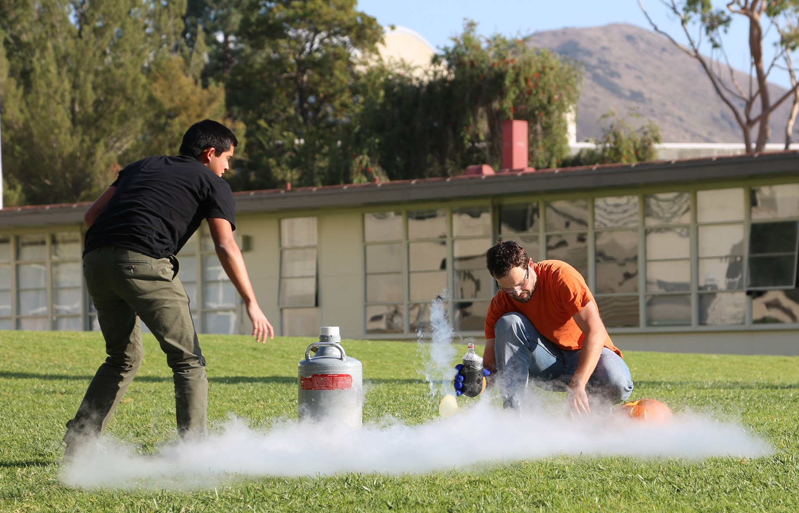
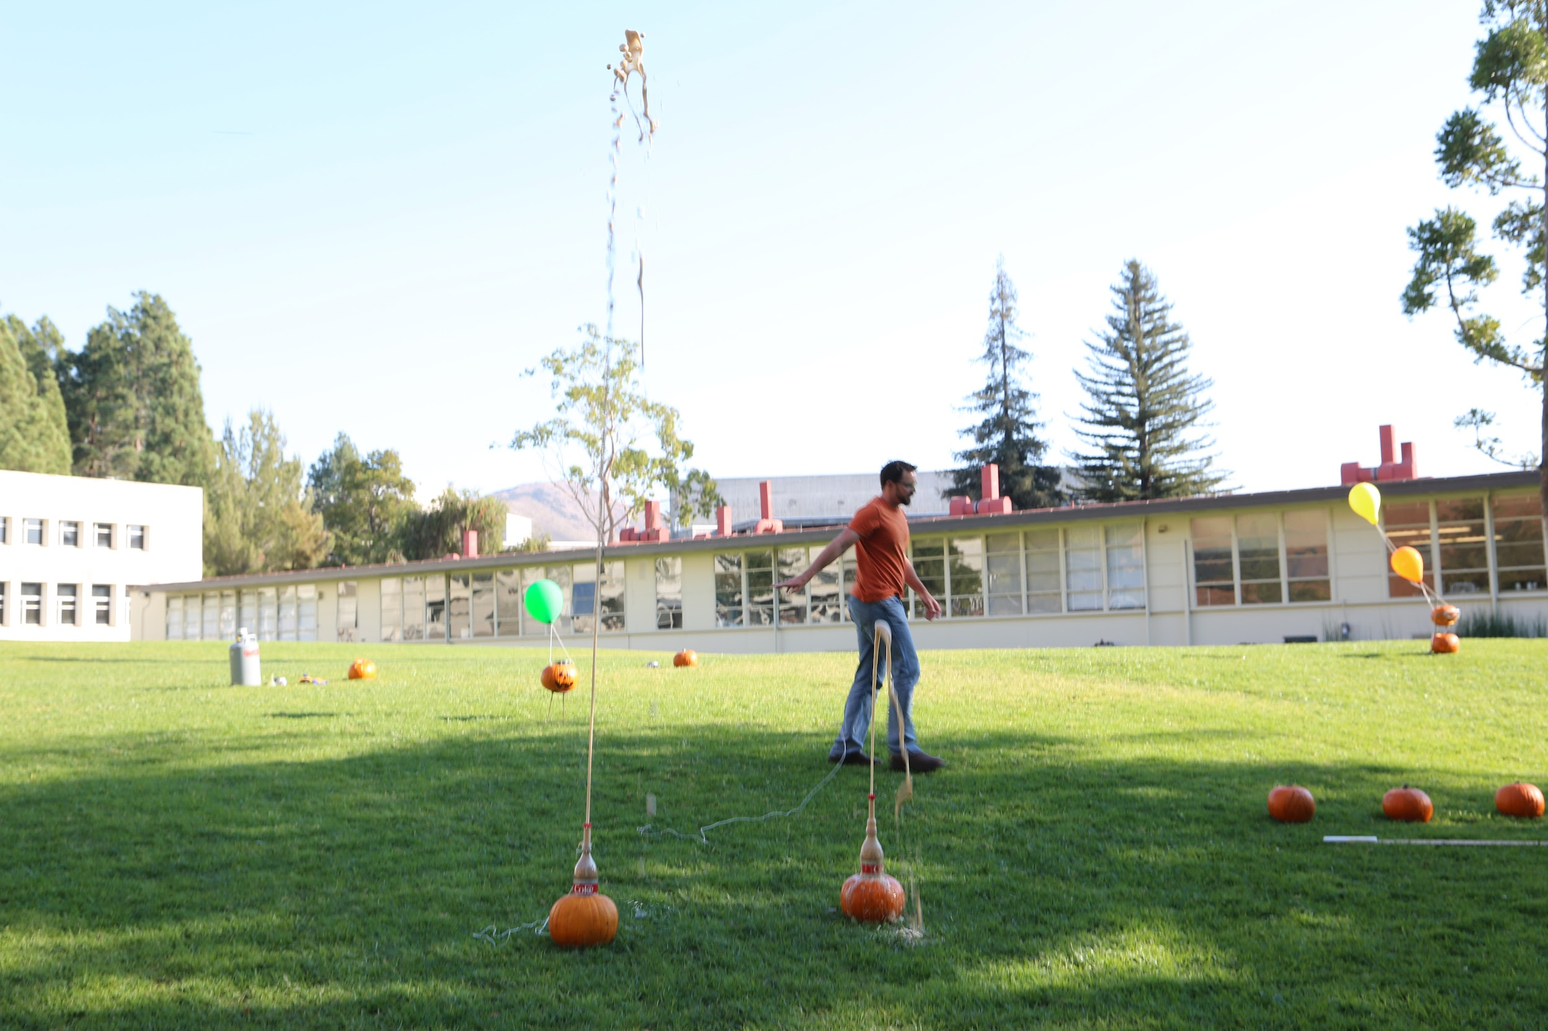
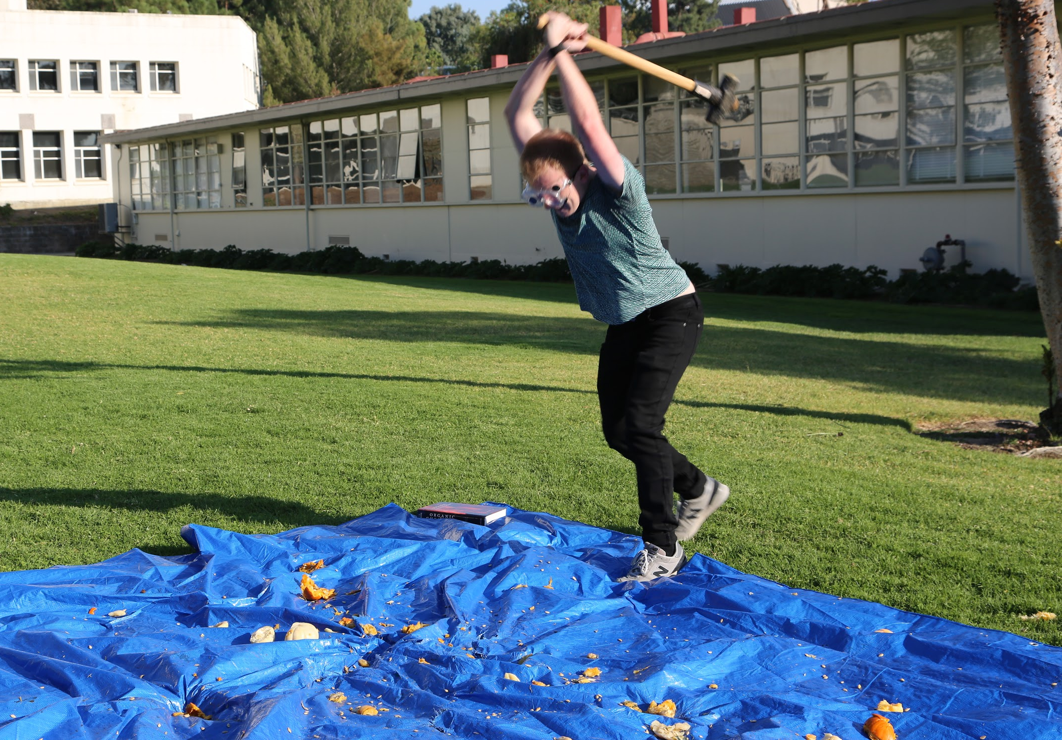
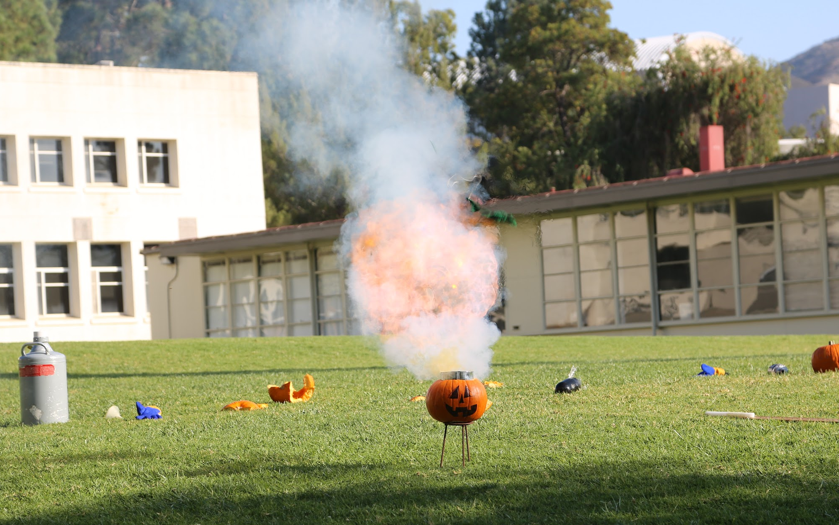
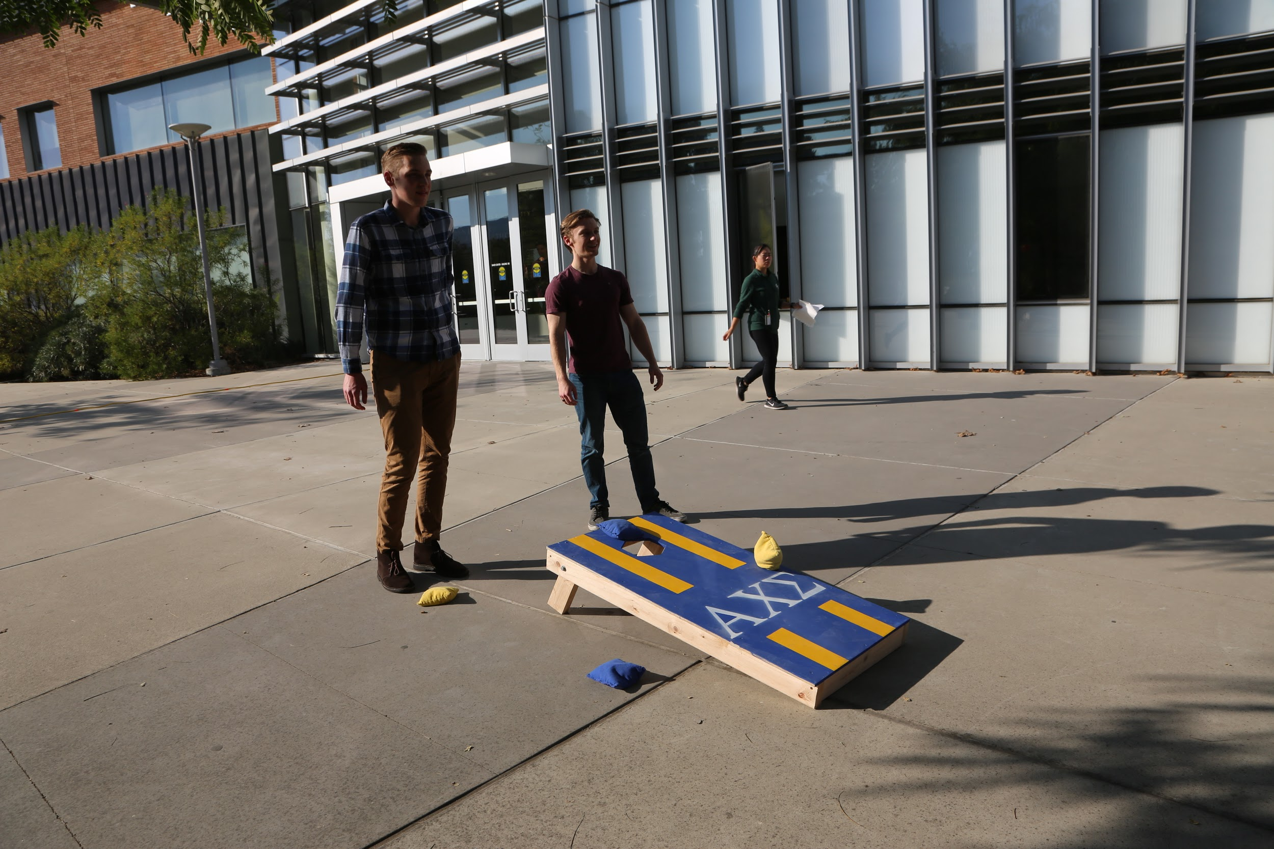
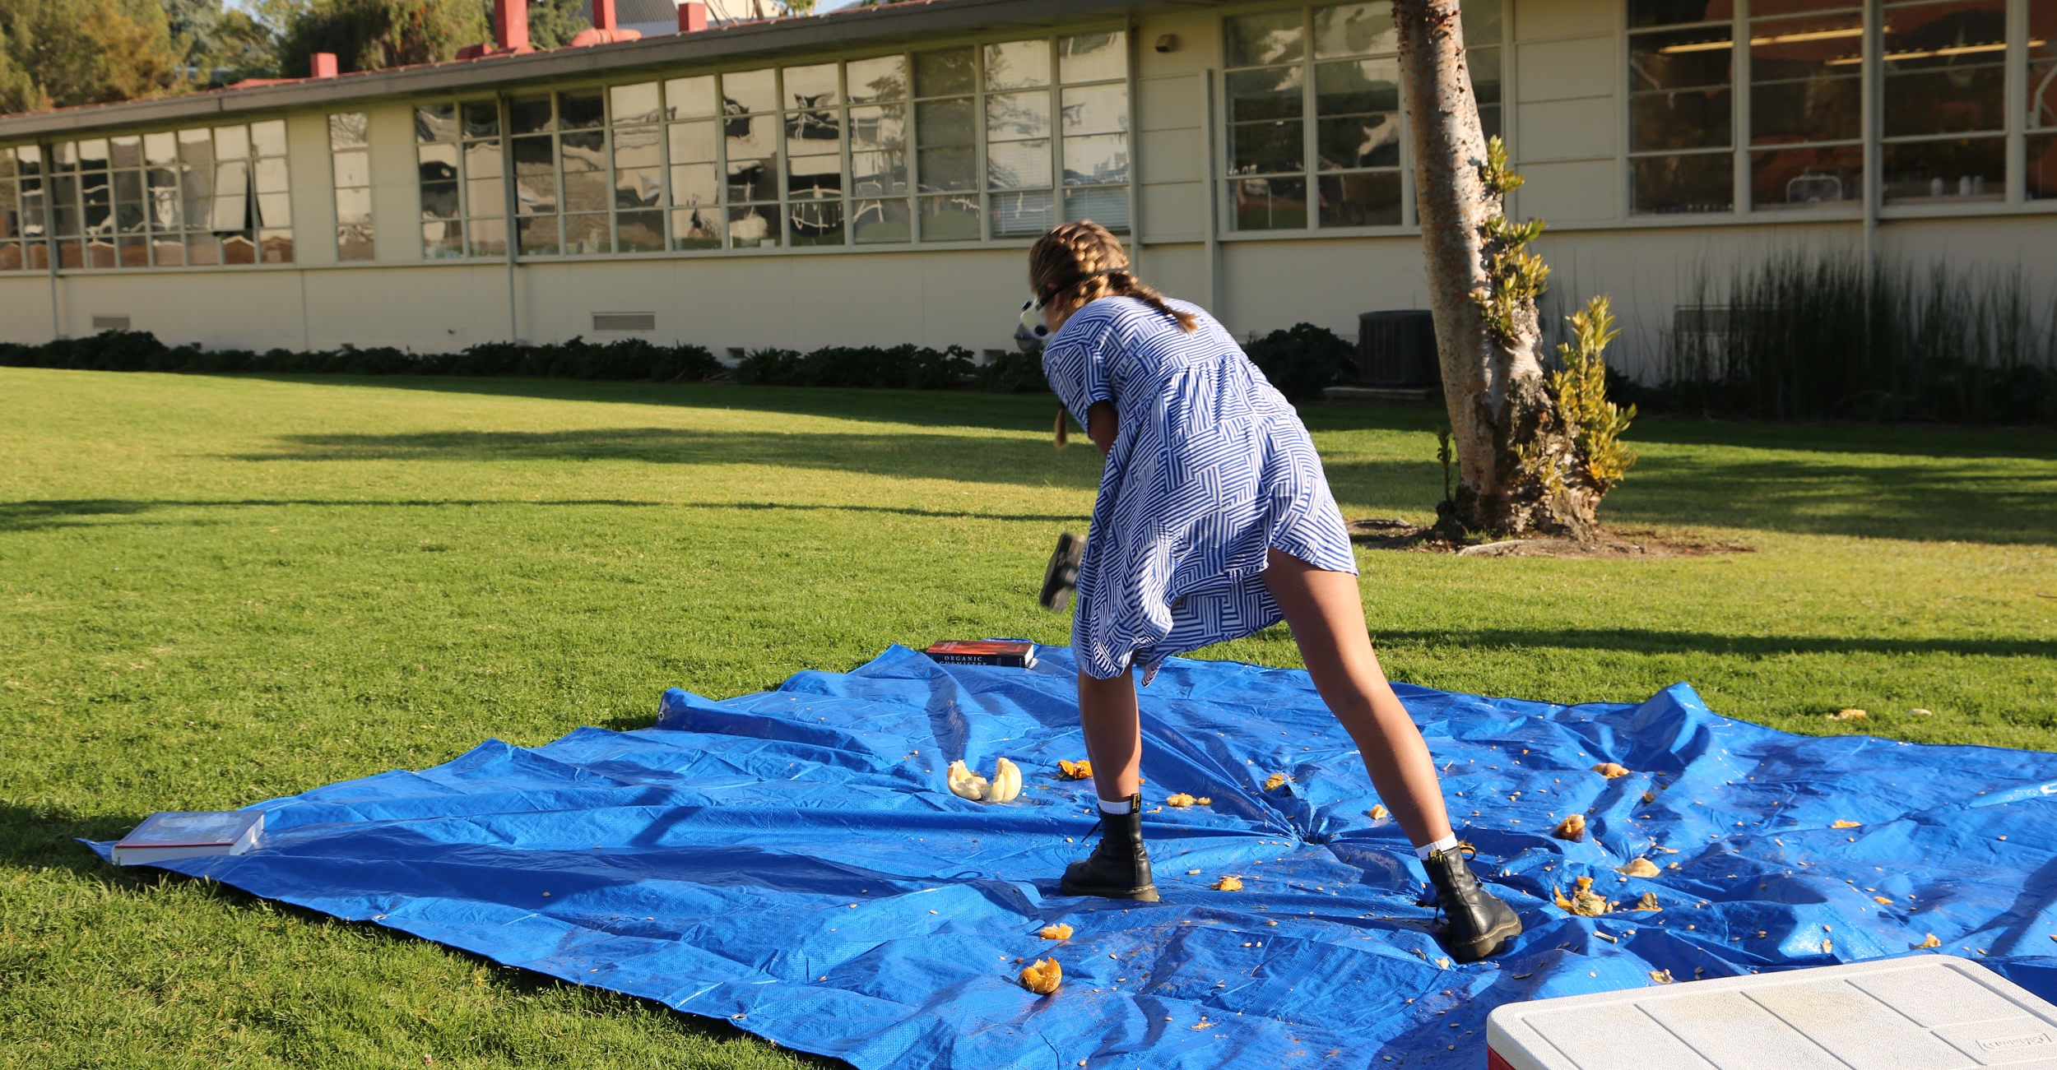
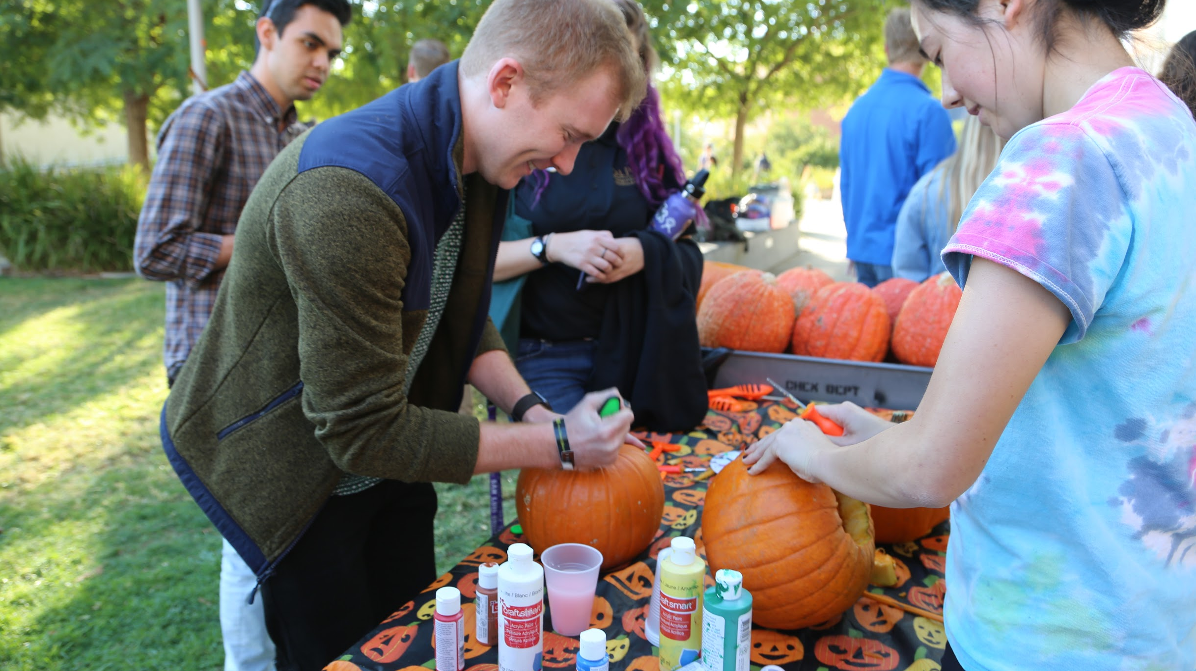

Slide 4
Video
Notes:
Embed video into presentation, insert>media>video. SAY THAT THIS VIDEO WILL BE PUBLISHED ON THE MACRO WEBSITE AND TUTORIAL DOCUMENT TO BE ABLE TO RECREATE THE EVENT

Slide 5
Organizing BYOP
Checklist in chronological order
Pick a date 3-6 weeks out near Halloween to allow for timely approval from school to host
Assign and meet with “BYOP Prep Crew” (~3 weeks before the event)
Crew will meet with the president, AXS recorder, and chapter advisor to discuss roles, tasks before the event, explosion demos explanation, and logistics
Advertise BYOP (1 and 2 weeks before the event)
Fliers
Department email announcements
Instagram posts

Slide 6
Organizing BYOP
Checklist in chronological order
Assign a clean-up crew for after BYOP (1 week before)
Incentivized for active body + pledges
Purchase supplies and check in with chapter advisor about pumpkin explosion demo chemical reagents (~1 week before)
Pumpkins, at most, should be bought 1 week before the event (to avoid pumpkin rot)
Assign day-of-event times
“BYOP Prep Crew” pumpkin demo preparation (morning of BYOP)
Active + pledge arrival (30 minutes before BYOP)

Slide 7
Day of BYOP
Pumpkin explosion demo preparations (morning of BYOP)
BYOP Prep Crew meets chapter advisor to carve pumpkins and ready chemical reagents
BYOP Prep Crew prepares Halloween candy goodie bags (post demo prep)
Actives and pledges arrive on the lawn and help prepare each required station (30 minutes before BYOP start time)

Slide 8
Day of BYOP
Station Set-Ups
Check-in Table: One table with money box, Halloween decorations, and safety forms
MC Station: Speaker and microphone set-up for music and announcements
Painting Station: Table propped up with tablecloth, small pumpkins, and painting materials
Lawn Set-up:
Smashing Pumpkin Station: Giant tarp on grass, bucket, goggles, sledgehammer, and frozen pumpkins
Pumpkin Explosion Demos: Set up by chapter advisor

Slide 9
BYOP Debrief
Post BYOP Details
Important to debrief with the chapter advisor over BYOP
Discuss what went well, what didn’t, and how to improve
Consider pricing of event to maintain attendance and engagement
If too cheap, no coverage for AXS
If too expensive, no one attends
Event has changed over the years
Began as pumpkin explosion viewing
Slowly added more demos (displaying different chemical reactions)
Became a well-rounded event (added pumpkin painting + smashing)

