Slide 1

Polymer Characterization:
Fourier Transform Infrared Spectroscopy (FTIR)

Slide 2
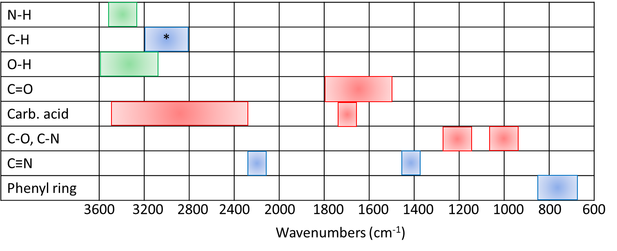
FTIR Overview
Covalent bonds absorb IR wavelengths, causing bond vibrations
“Band” = absorbed IR signature in spectrum
Band placement and band strength are characteristic of particular bonds
Some Common FTIR Bands
Blue: weak band (80 -100 % trans.)
Green: medium band (50-80 % trans.)
Red: strong band (0-50 % trans.)
*: Above 3000 indicates phenyl ring

Slide 3
Method Characteristics
Advantages
  Works on insoluble materials
  Uses small amount of sample (mg to μg)
  Different sampling methods adapt to many sample types
Disadvantages:
  Obtaining quantitative data requires significant standardization
  Spectra can be affected by sample processing history

Slide 4
Choosing a Sampling Method
KBr Pellet
  Easily prepared for correct signal strength
  Offers data on surface and interior material
Thin film, transmission mode
  Offers data on surface and interior material
  Film thickness must be controlled to obtain correct signal strength
Attenuated Total Reflectance
  Fast, easy, and non-destructive
  Only offers data on surface material (1-4 μm)

Slide 5
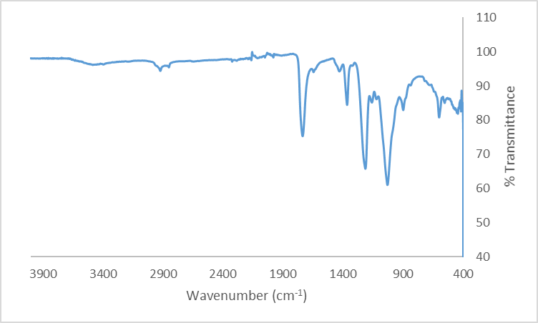
FTIR Uses:
Structure Identification
Presence or absence of bonds can indicate residual monomer, blended material, or decomposition products
Cellulose acetate
The FTIR spectrum of cellulose acetate shows the presence of C-O single bonds (950-1200 cm⁻¹), carbonyl groups (1735 cm⁻¹), and free OH groups (3400 cm⁻¹), indicative of partial acetylation of the cellulose backbone.

Slide 6
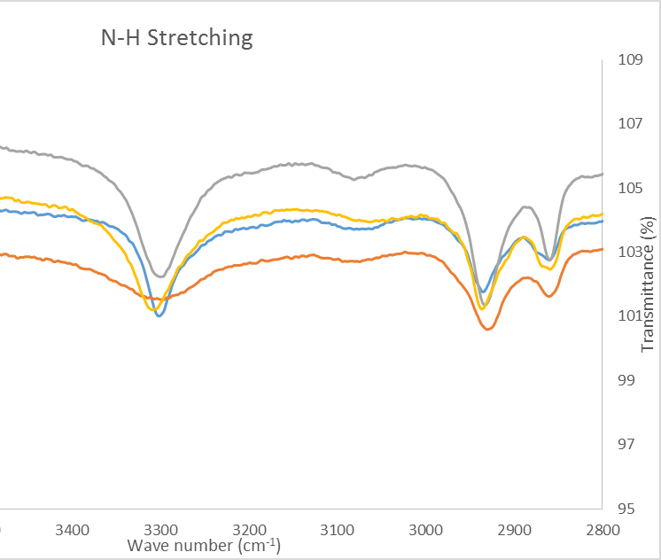
FTIR Uses: Crystallinity
High crystallinity homogenizes bond strengths, leading to sharper bands.
These samples of polyamide have been subjected to different cooling conditions, resulting in different amounts of crystallinity in the material. The blue sample has the highest % crystallinity, while the orange sample has the lowest. Lower crystallinity results in a broadened N-H stretching band.

Slide 7
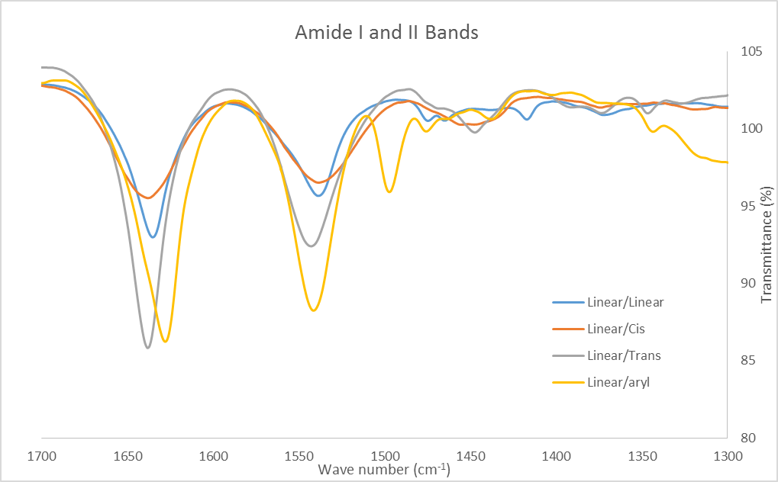
FTIR Uses: Bond strengths
Band placement is affected by bond strength. Bond strengthening due to intermolecular interactions moves bands to higher wavenumbers, while bond weakening moves bands to lower wavenumbers.
In these samples of polyamides, small repeat unit structure differences affect the strength of hydrogen bonding between amide groups. The strength of this interaction directly affects the strength of the C=O bond. For example: the gray sample has the strongest C=O bond and therefore the weakest intermolecular forces through hydrogen bonding.

