Slide 1
Polymers: Synthesis by Alkene Chemistry

Slide 2
Contents
Ionic polymerization
Propagation by Anionic Species
Propagation by Cationic Species
Propagation by Radical Species
Free Radical
Reversible Activation-Deactivation Polymerization
See special topics for additional details

Slide 3
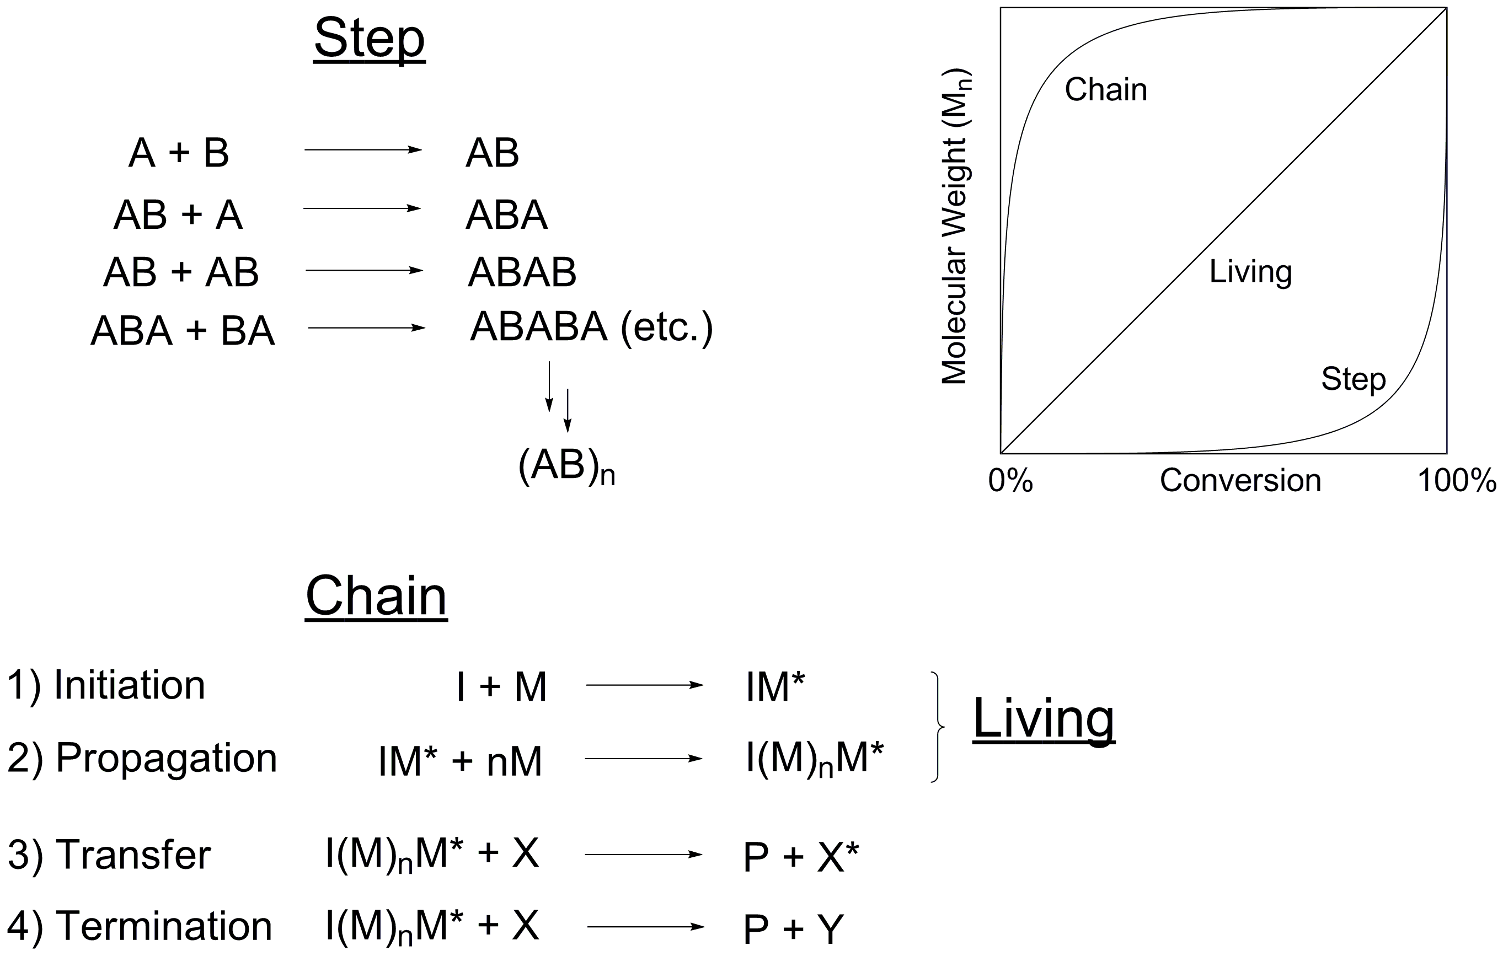
Classification by Mechanism

Slide 4
Molecular Weight vs. Conversion
Chain polymerization: High polymer + monomer in flask between 0-100% conv.
Step polymerization: Oligomers in flask between 0-100% conv.
Conversion is the percent of polymerizable functional groups that have been converted into backbone functional groups.

Slide 5
Chemistry of Ionic Polymerizations
Alkenes can act as nucleophiles,
with the propagating species a
carbocation. The R₁ group should
be capable of stabilizing the
charge.
Alkenes can also act as electrophiles,
with the propagating species a
carbanion. The R₂ group should
be capable of stabilizing the negative
charge.
Looking ahead: what might be examples of E+ and Nuc- suitable for the reaction steps above?

Slide 6
Cationic Polymerization
Notes:
Notes:
Rate expression is often more complex as the concentration of the cationic species is given based on initiating complex.

Slide 7
Anionic Polymerization
Notes:
Notes:
Rate expression is often more complex as the concentration of the cationic species is given based on initiating complex.

Slide 8
Basics of Radical Chemistry
Apply same fundamental steps as radical halogenation to polymerization
All of these steps are happening at the same time
Additional step
Transfer

Slide 9
Free Radical Polymerization
Just like any radical chain reaction, the first step is initiation. “make radicals”
Note the difference in the k_{d}, k_{i}, and k_{p}
Each step has a different rate and lead to complex mechanism questions
Common initiators are azo compounds and peroxides

Slide 10
Free Radical Polymerization

Slide 11
Inhibition and Retardation
Inhibitors stop the reaction
Retarders slow down the reaction
Inhibitor is consumed, polymerization begins

Slide 12
Reversible Activation-Deactivation Polymerization
Control achieved by minimizing radicals and therefore side reactions
Reversible deactivation by coupling
e.g. Nitroxide-mediated polymerization
Reversible transfer
Degenerative transfer / Addition-fragmentation
Alkyl iodides
Methacrylate macromonomers
Dithioesters / trithiocarbonates
Reversible deactivation by atom transfer
e.g. Atom transfer radical polymerization

