Slide 1
BYOP
(Bring Your Own Pumpkin)

Slide 2
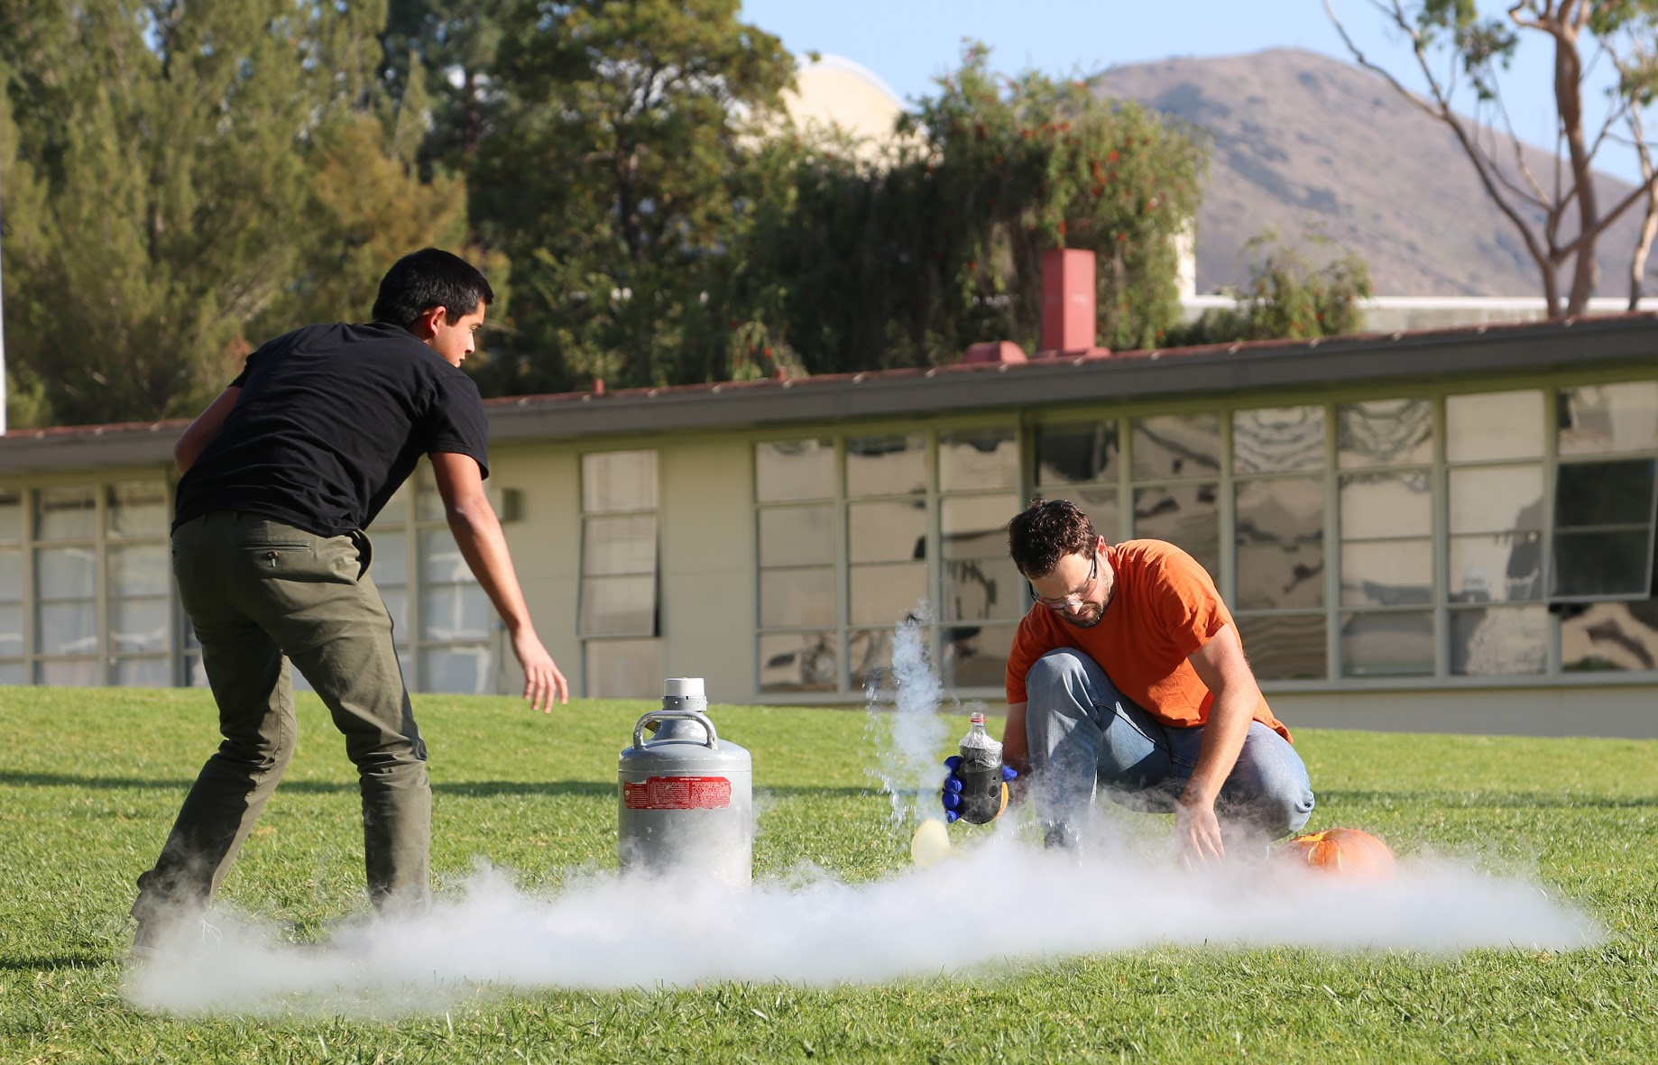
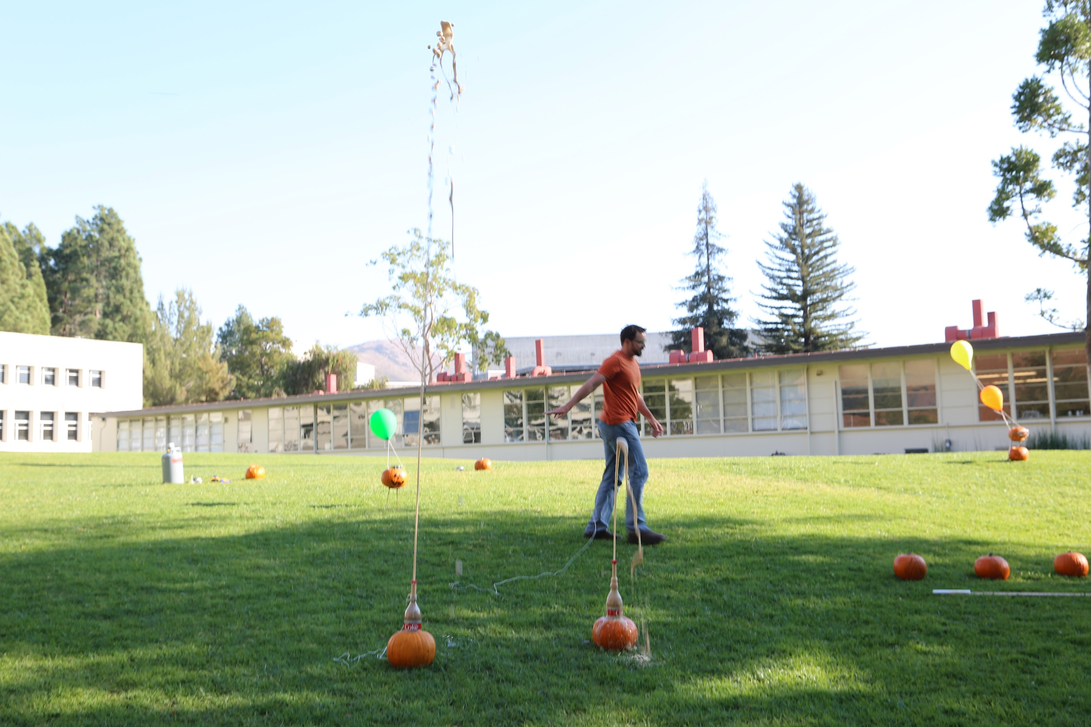
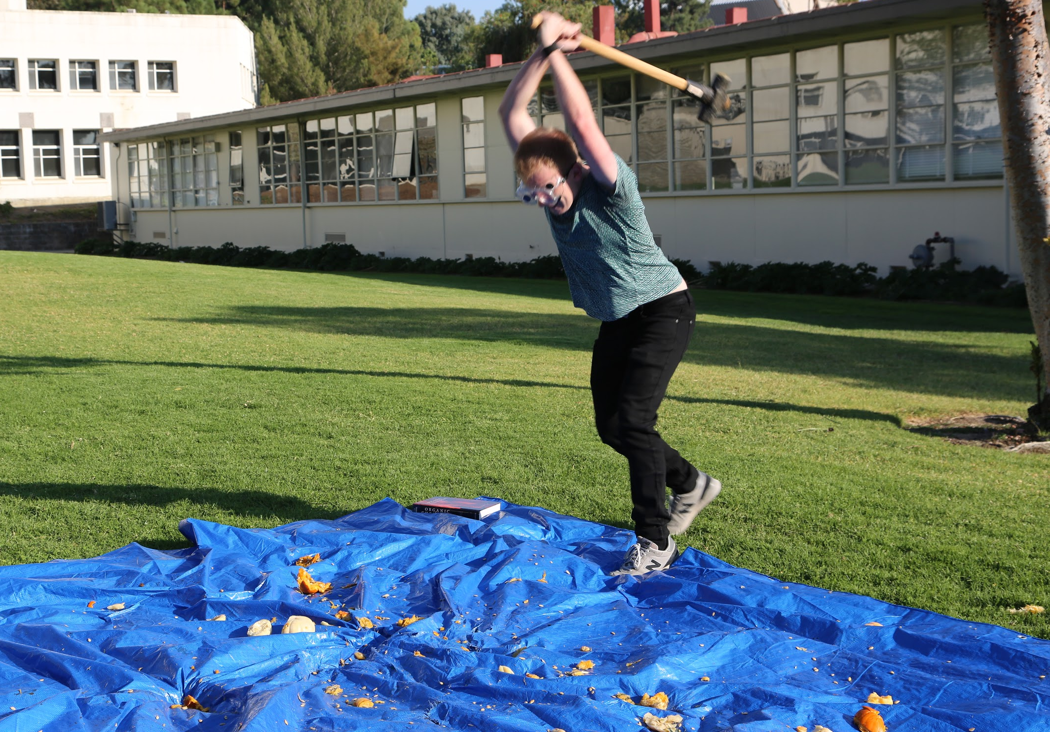
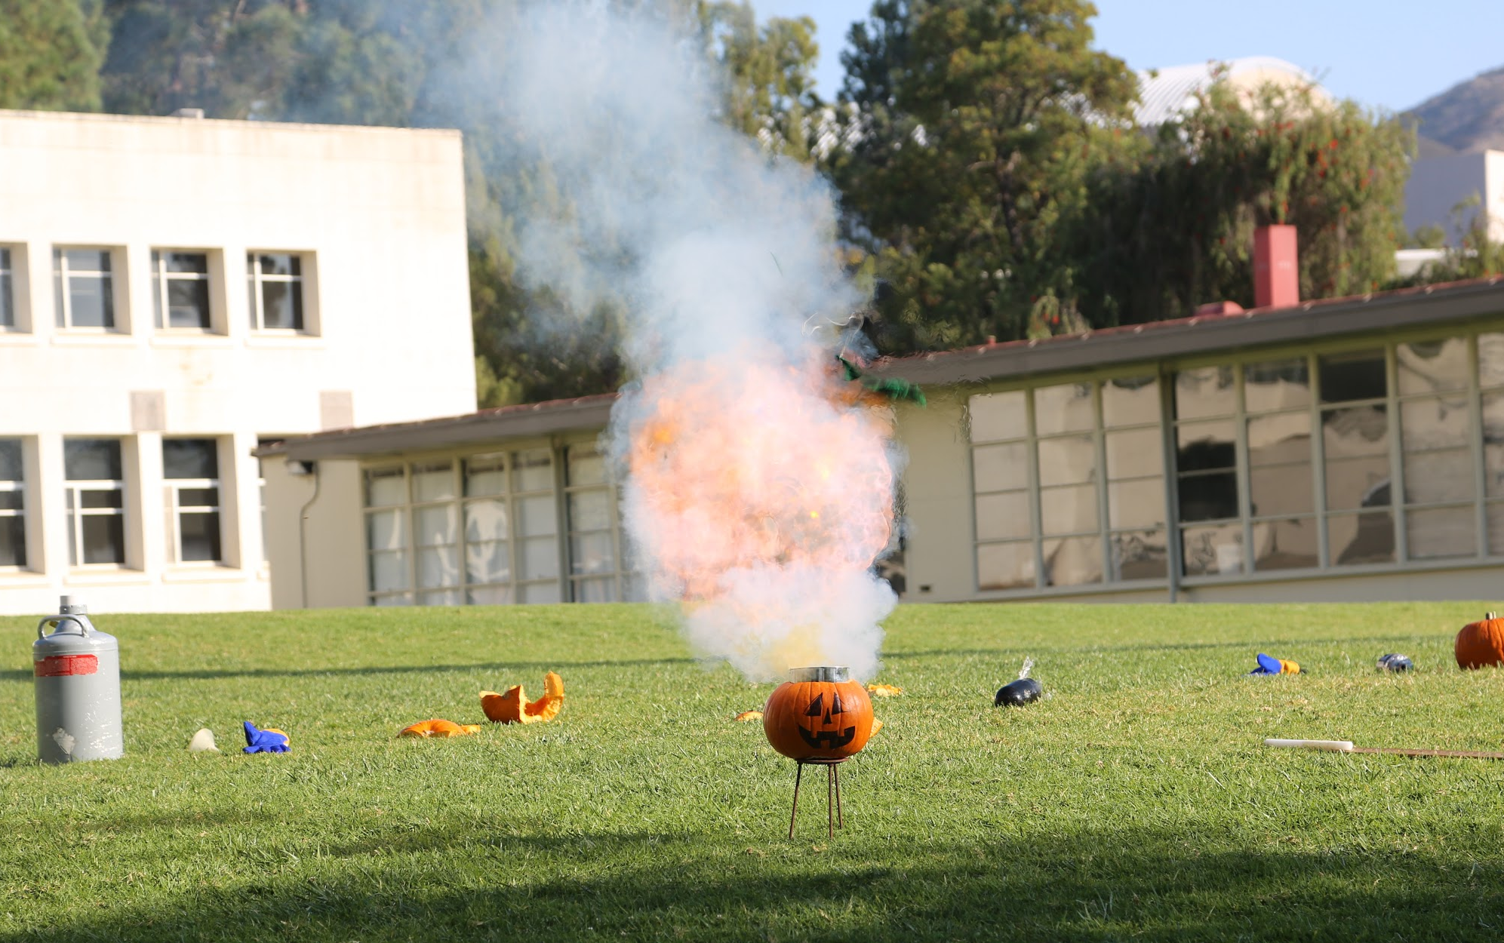
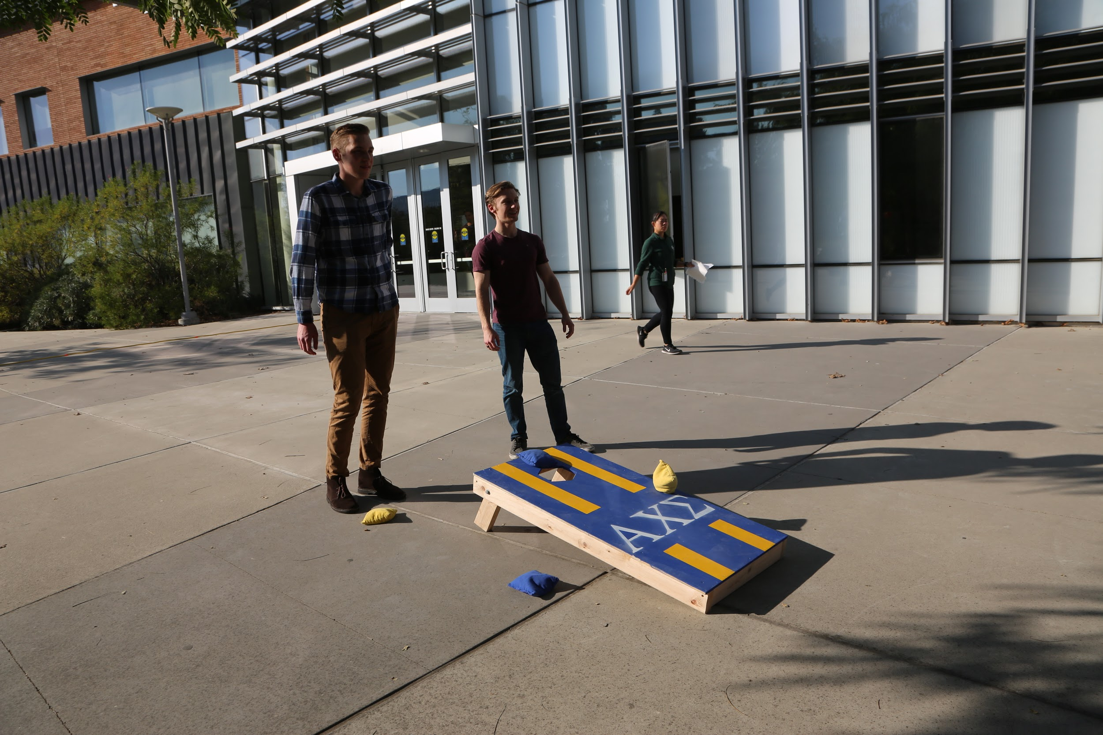
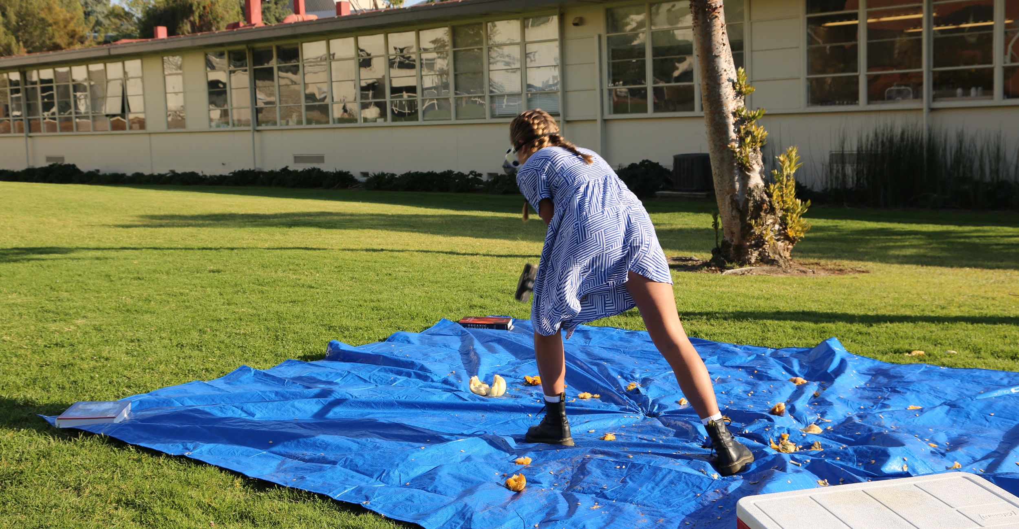
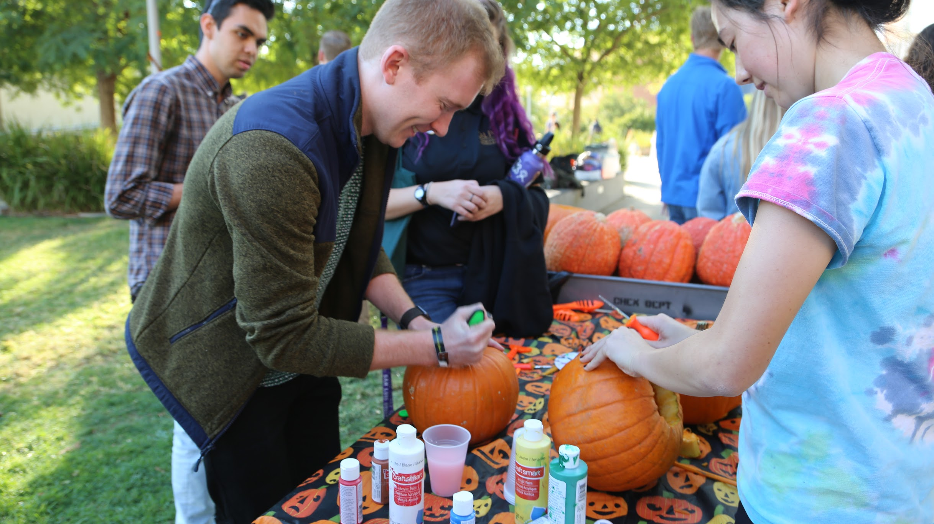

Slide 3
TABLE OF CONTENTS
1. Event Details
2. Brief Description
3. Prep Checklist
4. Day-Of Event Checklist
5. AXS Committee Descriptions
6. General Supplies
7. Pumpkin Explosion
8. Experiments and Supplies
FOR THE WRITTEN VERSION OF THIS TEMPLATE:
https://docs.google.com/document/d/1AHFzgfEOUSD6fUjyYQFpsyMGDEzfGA1rvUql-sxFwT4/edit?usp=sharing

Slide 4
EVENT DETAILS
1

Slide 5
Target Audience: College Students, Faculty & their families + kids (3+)
Event Goals: Spark excitement for science and Halloween through October-related science activities
Event Type: Outreach, Celebratory
Setting: Outdoor lawn on college campus
Time Frame: Fall season ~ End of October
Led by: College students, Professors (perform science experiments)
Approximate Cost: $200-250
Event Length: Two hours

Slide 6
BRIEF DESCRIPTIONS
2

Slide 7
BYOP is the Gamma Zeta Chapter of Alpha Chi Sigma’s October fundraising event. We advertise to the entire school for students and faculty to bring their family and friends. At the event, they can buy pumpkins from us to smash or paint or carve (the name is misleading but the fundraiser is selling pumpkins to attendees). The “main event” or incentive for people to come is our chemistry professor performing multiple pumpkin explosion demonstrations.
If pumpkins aren’t your thing, we also have other games for attendees such as cornhole, sports, costume contest, The Skeleton Walk (which has the same concept as a Cake Walk but people are given goodie bags of candy -- VERY popular with the kids).

Slide 8
PREP CHECKLIST
3
(CHRONOLOGICAL ORDER)

Slide 9
Get approval from the school to host the event.
Get the Prep Crew ready and assembled 1 month out before the event.
Meet up with the Master Alchemist and professor(s) performing the explosion demos (weekly until the event) and discuss roles, what needs to be done before the event, and other logistics.
Buy supplies for the event & make sure the professor(s) doing the demos have their supplies as well.
Pumpkins should be purchased at most 1 week before the event (so they do not rot).
Advertising Committee: Create & print out event fliers
Have them posted around the school 1-2 weeks out from the event.
Have AXS activists ask professors in the Chemistry Department to make announcements about BYOP during their classes.
Ask the Chemistry Department to send an email announcement with the digital flyer to all students on their email lists.
Assign people to Prep Crew & Clean-Up Crew (use pledges and incentivize with marbles).

Slide 10
DAY-OF EVENT CHECKLIST
4

Slide 11
Table and Decoration Set-Up
There should be two tables set up with decorations and table cloths on top of each.
Transporting Pumpkins to the Event Site
Get 2-3 people to transport pumpkins to the event.
Assemble Goodie-Bags
Place assorted candy into a candy bag. Make sure they are tied and place them at the CakeWalk Station (preferably in a bucket).
Cornhole Set-Up
CakeWalk Set-Up
Obtain 10-15 Halloween-themed images with distinct numbers and put the same numbers inside of a hat on separate pieces of paper.
Place the images in a circle and tape them down. Make sure the hat is ready with the numbers inside.
Carving Station
Set up the Carving Station on one of the tables after they have been set-up.
Painting Station
Lay out the paints one the second table after it has been set-up.
MC station (PA system setup)
Set up extension cords, if needed, and make sure the PA system is set-up and playing music.
Lawn set-up (tarp and pumpkins)
Smashing Pumpkin Station
Lay out a giant tarp and place all of the small smashing pumpkins on the tarp/in a bucket.
Make sure the liquid nitrogen has frozen them all the way through.
Explosion Demonstration (should be set up by professor performing the demos)

Slide 12
AXS COMMITTEE DESCRIPTIONS
FOR PREP CREW + CLEAN-UP CREW, HAVE PLEDGES HELP FOR MARBLES
5

Slide 13
ADVERTISING COMMITTEE
Print out fliers and hang up 1-2 weeks before the event
Have active sign-ups to contact professors and make announcements during their class periods.
PREP CREW
Tasks to Assign:
Setting up tables and decoration
Transporting pumpkins to the event site
Cornhole
Cake Walk
Carving Station
Painting Station
MC station (PA system setup)
Lawn set-up (tarp and pumpkins)
Smashing pumpkin station
Explosion demo (should be set up by professor performing the demos)
CLEAN-UP CREW
Clean up so we don’t get fined

Slide 14
GENERAL SUPPLIES
FOR TARGET AUDIENCE OF 20-30 PEOPLE
6

Slide 15
Item | Quantity | Where to Buy | What to Charge
Large Pumpkins | 15 | Local pumpkin patch
Small Pumpkins | 20 | Local pumpkin patch | $2 each on Venmo
Tables + Table Cloth | 2 tables | Dollar store
Seating | We did not provide extra seating because the field we hosted on had tables and places to sit - maybe encourage people to bring blankets to sit on the lawn | N/A
Cornhole | 1 | Already had
Candy goodie bags | Made 30-40 | Target/Dollar Tree
PA System | 1 | Already had - can rent from a media store/get tailgater
Cake walk place holders (Halloween-themed pictures with numbers on them) | 10-15 (place in a circle) | Printed out and laminated
Pumpkin Carving Kit | 2-3 | Dollar store
Paint | 1 set | Michael’s
Liquid Nitrogen | 1 | Chem Dept
Sledge hammer | 1 | Already had
Large Tarp | 1 | Already had
Trash cans | 1 | Used the ones around the field
Trashbags | 5 (just in case) | Chem Dept
Misc. Halloween decorations |  | Dollar store

Slide 16
PUMPKIN EXPLOSIONS
EXPERIMENTS AND SUPPLIES
7

Slide 17
Experiment | Description | Supplies (Amount)

